Slide 1
GRADIENT DESCENT
SWETHA C S

Slide 2
What is Gradient Descent
Gradient descent is an optimization algorithm.
It aims at minimizing the loss or cost function by iteratively updating the model's parameters in the opposite direction of gradient.

Slide 3
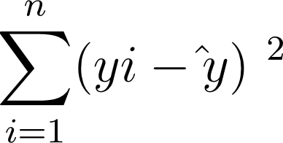
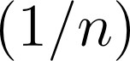
Cost function of Linear Regression

Slide 4
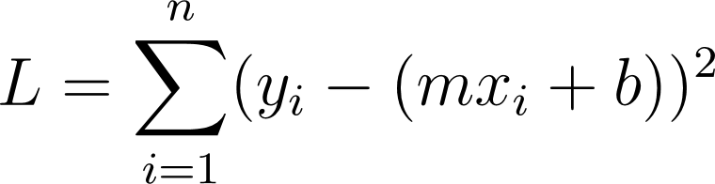
Algorithm
STEP 1 : Take the partial derivative of loss function for each parameter m and b.
Download

Slide 5
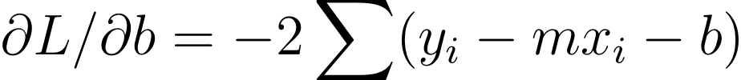
Partial derivate of L wrt m and b

Slide 6
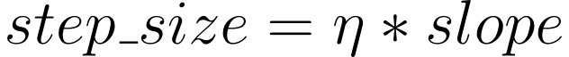
Step 2 : Assume random values for parameters initially
m=1 and b=0
Step 3 : Plug the parameter values into the gradient.
Step 4 : Calculate the step size

Slide 7
Step 5 : Calculate new parameters
New_parameter = old_parameter – step_size.

Slide 8
Step 6 : Go to step 3 and repeat until step size is very small or you reach max epochs.

Slide 9
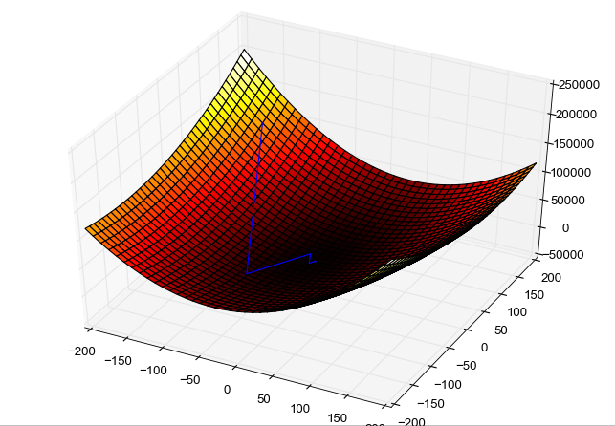
Global minima

Slide 10
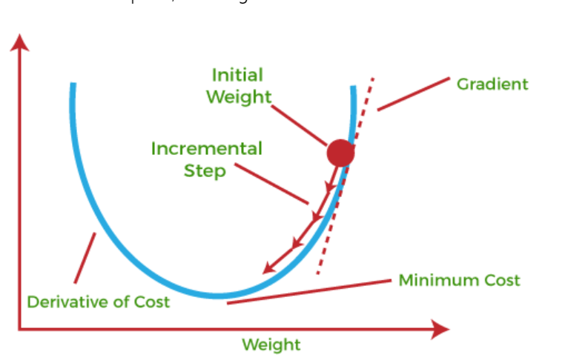

Slide 11
Types of Gradient Descent
Stochastic Gradient Descent
Batch Gradient Descent
Mini-batch Gradient Descent

Slide 12

QA

